Slide 1
National Health Leadership Programme Norway
Exploring a new model for a value driven partnership between academia and government
EFMD CASE 2019

Slide 3
SUMMARY
Governments make laws and policies and attempt to implement change in society from the top. Through law-making, funding, and decisions made by ministries, directorates and through public systems, changes are made and implemented across countries.
However, changes in ecosystems are never easy. Policymakers and professional unions tend to see the world differently. There are different perspectives on the problems and different opinions regarding how to solve a challenge. So many government policies and ideas are proclaimed and funded, but never effectively implemented. Not because they are wrong, but because systems and societies have a built-in resistance to change.
One such case is the Norwegian healthcare system where basically all the governments over the last 30 years have made decisions and policies that encourage the development of a more patient-centric healthcare system. It has proven very difficult to make changes in the internal logistics systems of hospitals and healthcare professionals. This type of change is almost impossible to make top down by enforcing something on the healthcare system.
This case is a story about how government and academia can work together in order to change ecosystems and how to combine policy level initiatives with bottom-up impact initiatives on a large scale in order to implement change and innovation in society. The case aims at explaining to policymakers how they should cooperate with academia and to academia how they can contribute and play important roles in a changing society.
In this case, government spends a limited amount of 20 MNOK; it procures not only leadership training but is assured delivery of more than 230 change and innovation projects across the kingdom of Norway, all focusing on aspects of improved patient experience. The combined value of this large-scale bottom-up mobilisation of initiatives within the health- and care services is already paying off and will continue to do so as volume and scale grow.
This has been a pilot project and an experiment addressing how government and academia can work together to bring value to society and improve the healthcare system. It is through the vision and dedication of the Directorate of Health and the Norwegian association of local and regional authorities that this has been possible.

Slide 4
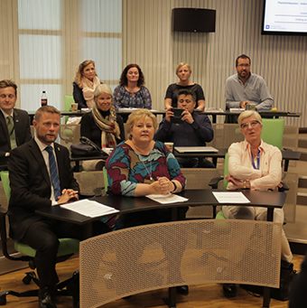
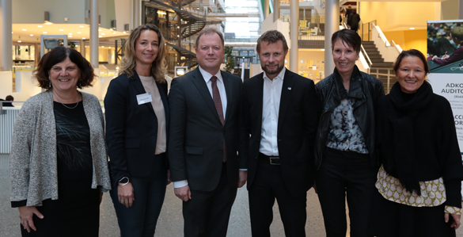
INTRODUCTIONS
PARTNERS
Norwegian Ministry of Health and Care Services
In charge of health policy, public health, health care services and health legislation in Norway. The Minister of Health and Care Services is the head of the Ministry, and is currently held by Bent Høie
The Norwegian Directorate of Health Is a specialized directorate for health and social affairs. The Directorate is an integral part of the central administration of healthcare in Norway and is organized under the Ministry of Health and Care Services and the Ministry of Labour and Social Affairs
The Norwegian Association of Local and Regional Authorities (KS) Is an employers’ association and interest organization for municipalities, counties and local public enterprises. KS preserves the interests of its members towards central government, the parliament, labour organizations and other organizations
BI Norwegian Business School, Oslo Norway BI is a Triple Crown School and is currently Europe’s largest business school in terms of the number of students. The Corporate Department has longstanding experience in working with the public sector in ecosystem change and is currently working at national level programmes for schools, kindergartens, health services, security and entrepreneurship. BI’s values are research-based, learning-oriented & sustainable
Representative from all the partners described over

Slide 6
THE CHALLENGE
The Patient – shift in demand
An aging population with increasing levels of lifestyle diseases demands more efficient processes and services.
Preventive measures are increasing, especially among the young population where people are becoming more proactive when it comes to health matters.
The digital revolution is reshaping the healthcare service sector, causing a shift in demands and needs. Access to information through technology and shared data will be necessary to reach the patient as well as redesign the services.
To meet the challenges in the primary healthcare – the Ministry of Health wanted to create a national leadership programme for employees in primary care. Through a tendering process in 2015 they chose partnership with BI.
Our sponsors in the Ministry of Health saw that to be able to facilitate health and well being for all, primary health care was in dire need not only of good management, but also confident leadership - leadership capable of facilitating and adapting to radical change and capable of creating a culture for professional, prosocial and empathic relationships among employees and towards patients and clients.
The healthcare system in primary care
Primary health care is challenged by aging and more demanding populations, pressure for decentralization of specialized services from hospitals and nursing homes, and disruptive developments in health and communication technologies.
Different levels of leadership knowledge challenge service quality and how to give the same quality to all employees.
Our programme focuses on stimulating personal leadership capacities, as well as the confidence and capabilities for driving change for a better future for the patients as well as the healthcare services. We believe the feedback and service transformation projects performed by our students indicates we have had a substantial impact on their leadership skills as well as on the services they direct and develop.
As a part of the leadership programme, every participant must identify, plan and execute an innovation, change or improvement project. The projects should be in line with the overall strategy of building a more patient centric and efficient healthcare system. The main value and impact created for the society adds up to the combined value of all improvement projects including new competence, networks and improved leadership skills.
"The challenge number one from now on will be to prioritize. Further, the leaders in the health sector will have to adapt to new circumstances in which patients have more knowledge of their own health. Leaders have to communicate with the patients accordingly and having professionals interact more closely and more efficiently. As a consequence of more knowledgeable patients, power between the patient and the professional will shift in favour of the patient”
Bjørn Guldvog – Director General of the Norwegian Directorate of Health

Slide 7
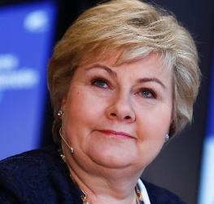
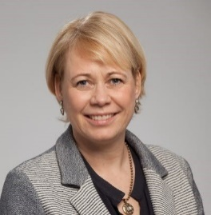
“As a politician and a Minister of Health I have visited many nursing homes all over the country. They have comparable funding, resources and personnel; however, they can be very different. As soon as you step inside the door you get a feeling for whether this is a good place to be for the patients or not".
There are major management challenges in the health and care sector today. This is due to both a lack of managerial expertise and a lack of managers. Therefore, we have increased allocations for National Leadership Education for the primary health service, reaching NOK 16.2 million this year. This leadership training was established in 2015 and is designed to address the challenges of the sector.
The awareness of patient nursing homes should be raised
It is not about nice buildings, facilities or great food, it has to do with leadership and management and their ability to put the patient at the centre and build a culture of respect and care.”
From an interview with Minister of Health Bent Høie
Bent Høie
Aftenposten -20 July 2016
"
“Elderly care implies that we need to work differently and learn from best practice. Therefore we need to challenge leadership and management.”
“Leadership is the Key!”
Prime minister Erna Solberg
The National Health Conference – 2017 & 2018
"
“The health and care sector is facing significant changes these days, with demands for innovation, efficiency and user involvement. As a manager, you have a special responsibility to act as a driving force for innovation and development. This requires expertise, skills and new ways of exercising leadership. Education is a golden opportunity to further your leadership skills together with colleagues from all over the country".
Anne-Cathrine Hjertaas Head of Department (KS) personnel policies

Slide 8
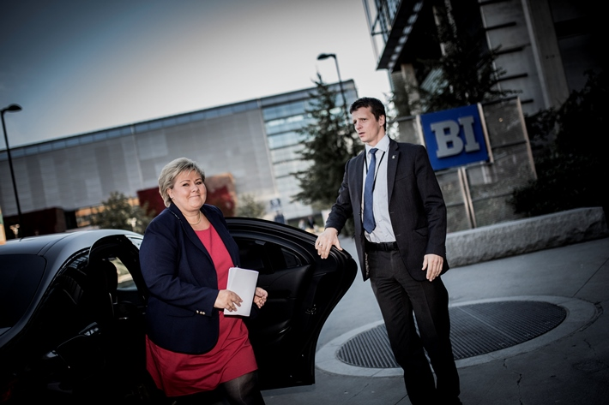
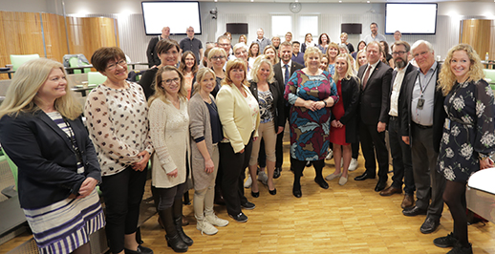
THE CHALLENGE
Late afternoon April 21st, 2017, BI Norwegian Business School received a phone call from the prime minister’s office. Prime minister, Ms. Erna Solberg, and her Minister of Health, Mr. Bent Høie, asked if they could come together and visit BI’s National health leadership programme, including time to talk with the participants. Why would the Prime Minister of a country prioritise one day to talk with the students in this programme?
When Prime Minister Solberg held her speech to the participants that day she knew that the initiators of 70 ongoing change and improvement projects were listening. She focused on empowering them as leaders of patient centric change and that their projects were important for the patients. “When you lead change, you will soon meet the glass ceiling of your superiors and your organization.” She encouraged them to push forward and use the support of their peers, mentors and professors. Prime Minister Solberg also promised to increase the momentum from the government, targeting 230 change and improvement projects in 2018.
The Prime Minister and Minister of Health visit BI – April 2017
What the Prime Minister understood was that to change an ecosystem she needs strong bottom up initiatives to match the policies of a government. In this way, the programme became an important tool for the government to improve primary healthcare

Slide 10
THE COMMITMENT
The Norwegian healthcare system is divided into primary healthcare managed by the municipalities, and the specialist healthcare directly controlled by the state. The Ministry of Health sets requirements for municipal primary healthcare through legal frameworks, funding and supervision, otherwise the municipalities have an independent responsibility for their healthcare services. With as many as 422 municipalities, the healthcare systems, traditions and challenges vary significantly throughout the country.
The initiative for the national leadership programme was taken by the Ministry of Health . The project team responsible for designing and developing the programme was a joint effort between Sigrun Heskestad, Head of department at the Directorate, and Anne Margrethe Fletre, Head of leadership at The Norwegian Association of Local and Regional Authorities (KS) and BI Norwegian Business School, dept. Corporate.
The strong value-driven alliance and excellent cooperation between the central government and the municipalities created an opportunity to develop a programme that combined bottom-up patient centric change and innovation with national policy. During the period from 2015-2019 there have been 648 participants and approximately 300 change projects will be delivered.
Letting a business school train leaders in the primary healthcare sector with a national ambition is a bold balancing act, both (1) because it may challenge the unions and the “system power”, and (2) because primary healthcare in Norway is the responsibility of the local county, not the state.

Slide 12
Learning & Development
Will the leader change the system or can the system change the leader?
Where the classic leadership programmes focus on the philosophy of developing the new leader, anticipating that improving leadership will induce needed change in the system, the Norwegian programme was designed differently
Our philosophy is that, to some extent, a customized programme should be the stone that induces ripples and then trains the leaders while dealing with the effects
After many years of experimentation with systemic change through customized programmes in close cooperation with the client, we have learned that we get most return on value when the client sees the programme as a strategic tool for change. The combined effect of hundreds of improvement projects in the healthcare sector brings more value to the patients than the combined new knowledge and improvement of leadership skills among the participants. Therefore, the core of the programme should be designed to manage the process and outcome of the improvement projects and to use academic teaching and leadership training to support the project execution and implementation. In this way, teaching and research become closely linked with practice and the faculty is challenged with regard to relevance and implementation of research.

Slide 13
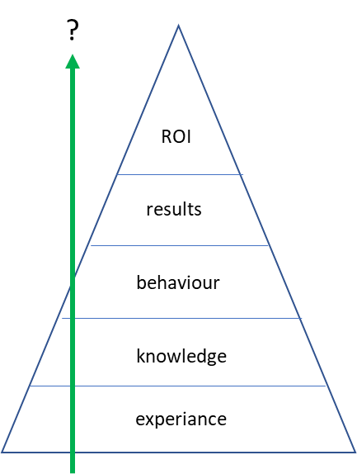
Learning & Development
Kirkpatrick’s (1965) thinking was that new knowledge leads to people changing their behaviors which again leads to results and impact which in sum leads to ROI. This has been challenged because changing people’s behavior and changing paths of organizations is far more complex and difficult.
The design of this programme concentrates on bringing about real results though a compulsory change project delivery that is aligned with the national policy level. In project execution, many challenges will be faced and problems have to be solved. Leadership training (behavior) becomes integrated as a support for the project delivery Content (knowledge) is chosen in order to support the problem solving and delivery of the project. The strength of the education system in eco system change is its scalability of many small bottom up change projects.
Working with professions, unions and hierarchy, many experience that system change and developing new solutions can be challenging. The innovation module at SDU focuses on training the participants in leading design thinking processes and involving stakeholders in driving innovation and change.
The leadership development is done alongside solving real challenges, hence innovation processes, strategy, planning, execution, individual development and managing stakeholders and training skills becomes an integral part of the project development and delivery process.
project

Slide 14
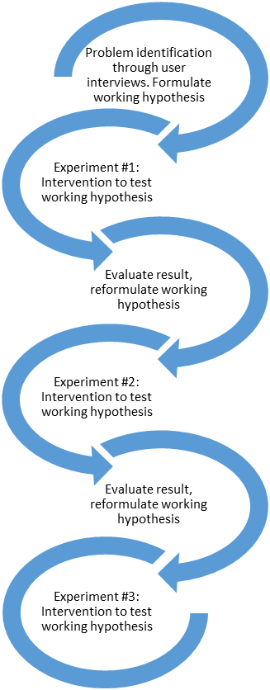
Learning & Development
The change project is design in accordance with design thinking and lean innovation principles. It outlines a process of improving the speed of learning while rapidly reducing uncertainty through frequent and practical interactions with users and stakeholders to test assumptions and propositions. This is done in iterative cycles, with as many small iterations as needed to develop and validate – and possibly implement – solutions to important problems.
The programme was fundamentally designed for high impact learning from the start. First, part of the design process was to outline the learning processes of the participating managers throughout the 9 months of the programme. To build sectoral capacity for innovation and change, the participants needed to start acting at once, interacting with their users and organizations to test their assumptions and initiating the change process, while interacting with academic knowledge and faculty to make sense of challenges, suggested solutions, and outcomes of interventions.
The curriculum in the programme consists of different academic themes for each of the six modules and was developed and ordered according to the learning design and its aims. This is a necessary “pull logic” of matching the learning design and needs of students with curriculum, lectures, exercises and tools in order to equip the students for their development and change journeys. Starting with knowledge, assessment and training on personal leadership and collaboration (module 1), the students get to start with themselves and their roles as managers. Then, creative tools of design thinking are combined with knowledge of strategic development of human resources (module 2) to enable exploration of the change project together with employees, users, and stakeholders. In module 3, the development of organizations, cultures and teams in healthcare is discussed, before introducing even more service design and innovation tools and methods in module 4, visiting Southern Denmark University. Towards the end of the programme, themes related to governance and finance (module 5) as well as healthcare legislation and ethics (module 6) are discussed to provide appropriate framing of change initiatives.

Slide 15
The participants The target group of leaders is geographically from all parts of the country and there have been participants from all 17 regions of Norway.
There have been about four times more applications then admitted participants. By June 2018 there were 430 leaders who completed the programme. About 30% men and 70% woman.
2016 2017 2018
~14% from north region
~ 21% from middle region
The split by professions:
54%
Series
~ 24% from west
16%
9%
8%
7%
~34% from
East
Nurses
Other
Dentists
Learning Disability Nurse
Physician
Fysical therapist
~ 7% from
South

Slide 17
THE IMPACT
As the Prime Minister indicated, the combined actual change and improvement in society delivered through 230 projects during the last for years is the key impact from the programme. With reference to Kirkpatrick’s model, it is results delivered which on an aggregated level deliver return on investment and value to society. One could also argue that an individual and a team that is trained and supported to deliver a project is likely to initiate new projects and use his/her new capabilities to induce more innovation in the years to come.
1
Project value
The participants have learned from practice and implementation of a real project (forced learning through practice with support). The content of the programme has been tailored to address the key challenges participants will meet and through the projects they have created value.
2
Agile workforce and network
The education programme has created an agile workforce able to adapt quickly to challenges in the sector and to create an engaged leadership culture. A learning network has been established and participants interact with each other through digital platforms
project
3
Individual level
Evaluation after the course, done both by BI and external third party (Rambøll), find that participants have gained increased knowledge and skills, as well as strengthened their competence in the leadership role.
The philosophy of this programme has been to use education and training as a powerful tool to enable governments and society to work with academia to drive and deliver distributed bottom-up change.

Slide 18
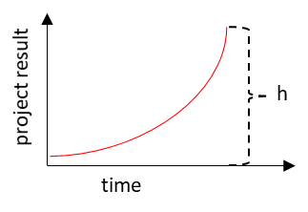
1
Value of projects
In sum we have about 230 project assignments
"
A key question should be: “Does the initiative bring return on the investment?” In the public sector this does not mean return in terms of profit, but rather value for society at large, both short term and long term.
“Through our projects and my classmates’ projects we are able to address real issues within primary care and create impact. I'm more confident than ever that I will actually make a real change.”
Participants
In an attempt to describe the impact of this type of programme, we would look at the value created by each student project. Every project will have an impact “height”, some projects with incremental impact/value, and others with higher impact.
Long term effects: If a project is implemented, it is likely to have long term value, beyond the duration of the programme. If a leader improves his/her capability in terms of innovation and change, it is also likely that this person will initiate new projects after the first is completed. In other words, the long term effects are linked with the project and/or with new competence/knowledge and possible change of behavior.
Examples of projects delivered
National standard for school health services | Develop and implement a national standard for the school health services. Resulted in national implementation 2019
From idea to ltd. Company | The establishment of Prio Health to serve an elderly population with patient centric adapted home care
Youth Help Initiative | How to develop and organize the cross departmental social youth support services in Lier municipality
Developing a palliative care unit | How to develop a palliative care unit with better competence to deal with a patient’s last period of life and their families.
Training nurses in the new digital patient journal system | How can a leader support learning and implementation of new digital journal system
How to develop patient centric culture in a city district in Oslo | A city district finds it difficult to build a solid professional patient centric culture when most employees work part time. How to deal with this challenge?
How to secure retainment of nurses in Gran municipality | The municipality has challenges with recruiting and retaining nurses. What can be done in order retain nurses when first hired?
Shaping People and Healthcare Services for a Sustainable Future

Slide 19
1
Value of projects
Project example
Melhus was participating in the course at the same time that the municipality was undergoing a major restructuring process. During the course, the members of our management team learned that we needed to find and utilize our scope of action and opportunity to improve health and care services. As leaders we need to contribute actively to ensure innovation and development of the services we provide, in order to generate confidence in mastery and create flexibility for employees who want to work smarter. The education provided us with greater insight into what leadership is and how we can use our scope of action as work tasks constantly increase while resources remain stable.
The programme has helped us build a common leadership base, given us insights into new management tools and provided us with important skills for implementing change
The Municipality of Randaberg is a pioneer in elderly reform with our "On the farm" project where people with dementia participate in daily activities related to farm life.
The project has kept people with dementia in the municipality out of institutions longer, which saves the municipality a lot of money and provides people with dementia with a meaningful daily life.
Trude Wikdahl
Head of municipal affairs for health and welfare Melhus
Siw Diane Myhre
Muncipialitiy of Randaberg
“ I learned about innovation and innovative thinking and that as a leader I had to dare to make a place for myself. I found the skills and learned some tools that I could use in the process of creating this project. I had very talented colleagues and professionals to advise me, and I managed to get local politicians to contribute funds to find professionals to get On the Farm running.”
"Our project started with the idea of making small improvements, and ended up as a service innovation"
Home care manager in Melhus
Siw Diane Myhre

Slide 20
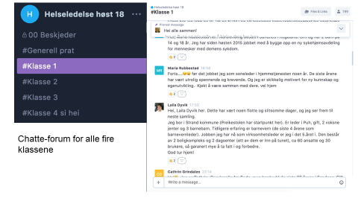
2
Agile workforce and network
Early in the programme, students comment om how important it is to share experience and ideas with each other. The keyword is networking. This is also highly underlined from the Norwegian Ministry of Health and Care Services and KS. To be relevant, not just during the programme, BI is in charge of seminars with national and international lecturers, inviting former and present students to take part. Here we share new research, best practice and also present students’ own project assignments. To be able to have a dialogue on a more daily basis, we have introduced “Differ” to the students. This is because we believe sharing cases and how to solve them in a good way brings the sector forward.
“Differ” is a communication platform for leadership development that is used for network, group work, mentoring and colleague guidance. Differ as an chat-app works, along with Facebook, as a community and a leader network for all health leaders across the country during - and even after completing - the programme.
The Programme Committee was established to organize alumni activities relevant for former and present students. They organize annual symposia focused on the broad current and future leadership challenges and solutions for primary health care. Head of the Committee is a faculty member in Healthcare Management and the first Minister of Health in Norway. An addition to members from BI, six former students who have written project assignments with impact on society are selected to the committee. The learning from this dialogue sessions goes both ways, keeping both faculty and students updated on current leadership issues and practice
Differ

Slide 21
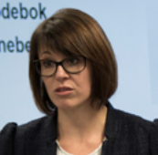
3
Individual level
“The most important thing for me was becoming aware of how my working life and influence from other leaders had shaped my leadership style and limited the scope of my actions.
Knowledge, motivation and reflection during and after the master's programme have contributed to the fact that I can now envision a future that I create and form. I have realized that, as a manager, I can create meaning contexts so employees interpret a situation in the direction I want. I look forward to the continuation of this master's programme"
The Directorate of Health hired the consulting company Rambøll to do an independent evaluation of the initiative. The report was delivered in 2018 and some of the key findings in the evaluation were:
Participants say that the programme to a high degree has helped them to
Be more confident in their leadership role
Be more innovative
Increase their execution abilities
Interviews done with colleagues of participants show that the participants have greatly improved their competence though the programme and have succeeded in strengthening their leadership roles. The programme has improved the leaders’ abilities to initiate change and innovation projects.
BI has done its own surveys of student satisfaction. The total overall satisfaction score for the class of spring 2018 (55 students) was 8.7 out of 10.
Tanja Tomasevic, Head physician of section
"The programme contributes to good learning environments and high-paced learning. The pedagogical design seems to promote a form of learning and training that will influence the individual student's workplace, and in the long term for the sector as a whole."
"Guidance from colleagues was valuable and they showed me that a manager in my municipality faces the same challenges and opportunities as managers in other municipalities"
From Rambøll evaluation the participants score (1- 6 scale)
"To what extent does the programme promote changes for you as a leader "
Knowledge
Middle manager
Skills
Overall competence
Nursing home managaer
1
6
Very little
High degree
Notes:
M. T : ikke først har lært for å gjennomføre.
Individets læring er endringsprosjektet og nettverket de har opplevd/vært med på. Har vært med på en utviklingsprosjekt jeg har vært med på.

Slide 22
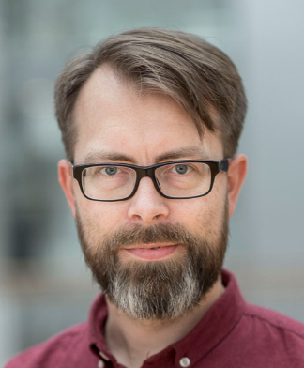
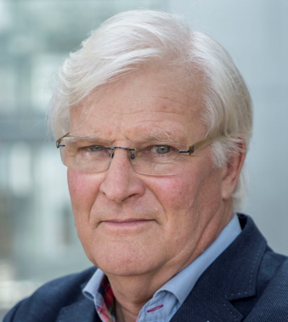
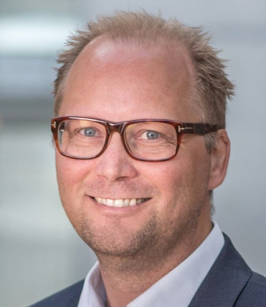
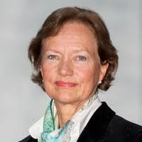
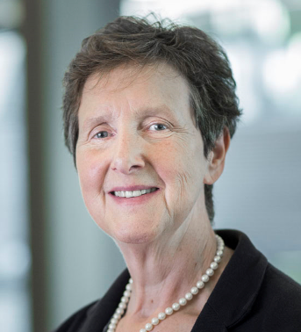
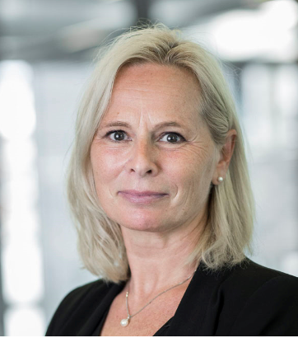
The lead faculty team
Professor and programme director, Thomas Hoholm, Head of faculty team, has a strong background working with entrepreneurship, innovation and accelerators.
Werner Christie, Norway’s former Minister of Health and Senior Lecturer at BI
Bjørn Erik Mørk, Associate Professor of Innovation and Associate Dean for the PhD specialization in Innovation and Entrepreneurship
The administrative team
Nina Elstad
Hilde Nordli
Rita Tveiten
Beate Halvorsen
Beate Nilsen

Slide 24
Appendix 1
Programme description
There are two parallel and complementary ‘learning tracks’ within the programme:
Changing the organization through an innovation/change/improvement project (done in groups or by individuals)
Starting from the insight (from entrepreneurship) that no service proposition survives its first meeting with users, the first task is to identify an important problem, and to explore it with stakeholders such as service users, colleagues, top management and related services, leading to reformulating the problem statement, and anchoring the project with stakeholders.
The next three stages consist of (a) proposing a solution, (b) testing core aspects of the solution with stakeholders through prototyping or change interventions, and (c) involving users in evaluating and reformulating the solution proposition, before embarking on another round of testing. And then another one.
Ultimately, during this process, the change initiative is not only tested and validated, it is also already fully or partially implemented into regular practice. However, this process is also designed so that ‘negative’ outcomes are possible: The proposition may be falsified, or turn out to be more complex than anticipated. This is very important and valuable learning to participating managers.
The exam paper is used to (a) document the innovation and change process, and (b) use academic knowledge to reflect upon and discuss the process and its outcomes.
Developing leadership through the personal leadership development journey. Most Norwegian healthcare managers are healthcare professionals by training, while not necesssarily having studied leadership and management. The complexity and challenge of leading in turbulent times, however, requires each and every healthcare manager to develop their leadership roles and skills to an accordingly professional level. The leadership development track starts with knowledge of evidence based leadership, and personal assessments through a Big 5 personality test, and a scientific 360 degree feedback exercise within the leader’s organization. Then, leadership goals are established, and training, reflecting and sharing will happen within and between every remaining programme module. A personal logbook is used for individual documentation and reflection. An individual home exam by the end of the programme is used to help students describe and use knowledge to reflect on their leadership development process.
Academic coaching is intensified during the two last modules, to help the students report, reflect on and discuss their processes and outcomes in terms of related research bases knowledge.

Slide 25
Appendix 2
Examples of projects delivered
National standard for school health services | Develop and implement a national standard for the school health services. Resulted in national implementation 2019
From idea to ltd. Company | The establishment of Prio Health to serve elderly population with patient centric adapted home care
Youth Help Initiative | How to develop and organize the cross departmental social youth support services in Lier municipality
Developing palliative care unit | How to develop a palliative care unit with better competence to deal with a patient’s last period of life and their families.
Training nurses in the new digital patient journal system | How can a leader support learning and implementation of new digital journal system
How to develop patient centric culture in a city district in Oslo | A city district finds it difficult to build a solid professional patient centric culture when most employees work part time. How to deal with this challenge?
How to secure retainment of nurses in Gran municipality | The municipality has challenges with recruiting and retaining nurses. What can be done in order retain nurses when first hired?

